Slide 1
MUSIC WEBSITE
By- Ritvik Maurya-bca
Akhil Kumar-BCA

Slide 2
Contents:
Introduction
Project Description
Tools which were used
Objective

Slide 3

Introduction:
Simple Music Website project made for the SAITM project Competition by BCA 3rd Year.

Slide 4


Description:
. A simple music website using html, css and js
.This website provides the user different samples of song which they want to listen to or save/download.
.We also provide a Image slider which contains different genres which the user can click and will be redirected to that genre page.
. One can also select more songs menu where they will be visiting the browser section with multiple genres and music to select.
.We also provide a user friendly Chatbot named Ritkil which can also play rock, paper and scissors but he is very strong in it.
Project Description

Slide 5

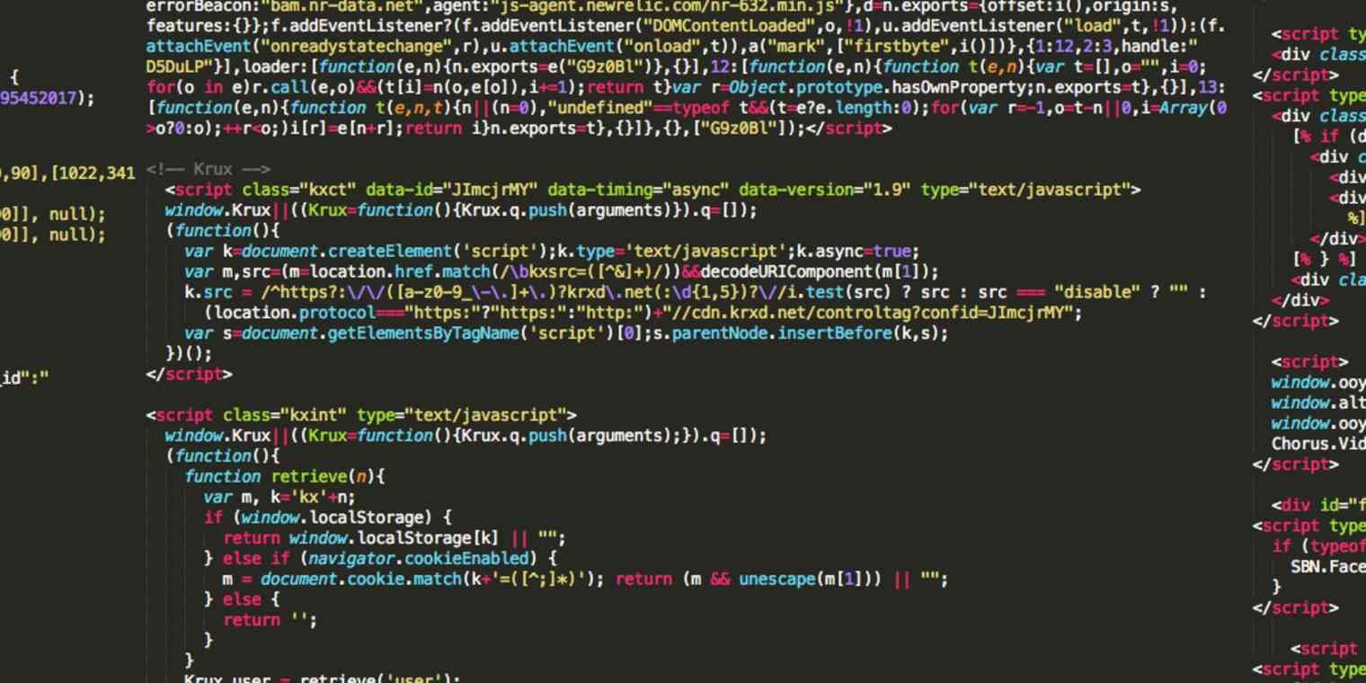

Project
Tools

Slide 6


Slide 9
THANK YOU!!
By- Ritvik Maurya
Akhil Kumar

